Slide 1
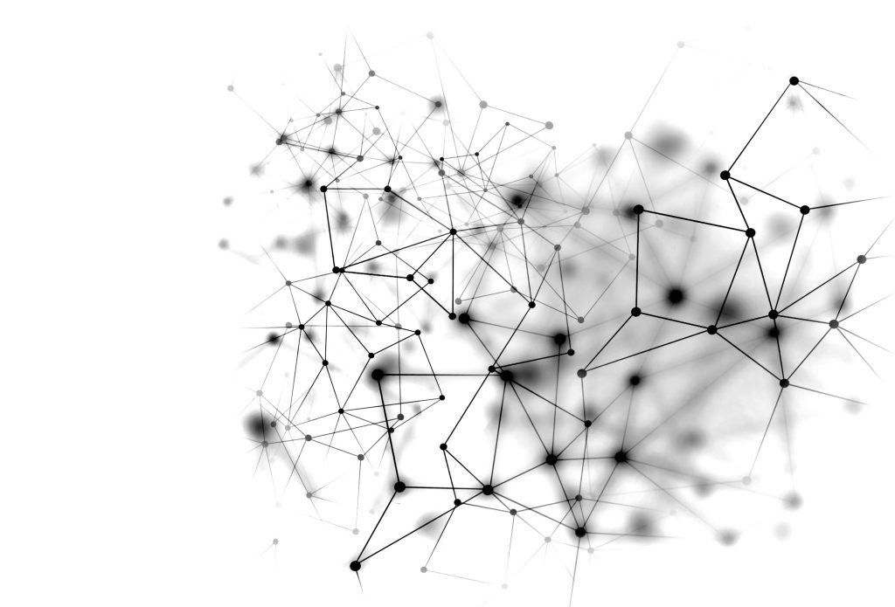
PREPARED BY: Abdulrahman Ramsey Momodu
Student ID: 100864843
Date Submitted: 26/11/2022
FINAL PROJECT
NAÏVE Bays, Logistical Regression & Neural network
Professor Sam
Plati Data-1200-04-Introduction to Data Analysis

Slide 2
RATIONAL STATEMENT
Rational Statement
Mr. John Hughes is faced with the challenge of identifying the best model to predict liver disease.
Mr. John Hughes wants to create forecast models using the following algorithms: (a) Naive Bayes (b) Logistical
Regression ( c) Neural Network
The dataset has 199 observations and 11 variables:
10 independent variables and one variable

Slide 3
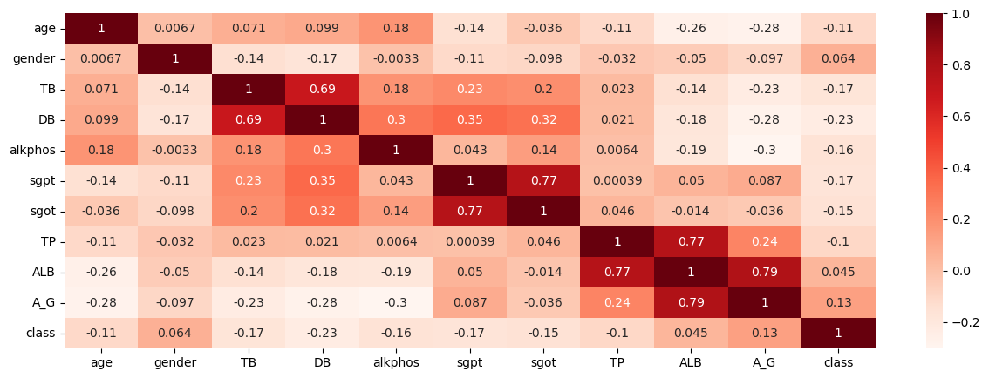
CORELLATIONAL HEATMAP 2Key Insight

Slide 4
CORELLATIONAL HEATMAP 2Key Insight
Insight
SGOT :SGPT and ALB:TP. Has the same inter-correlation point of 0.77
A_G: ALB Has the same inter-correlation point of 0.79

Slide 5
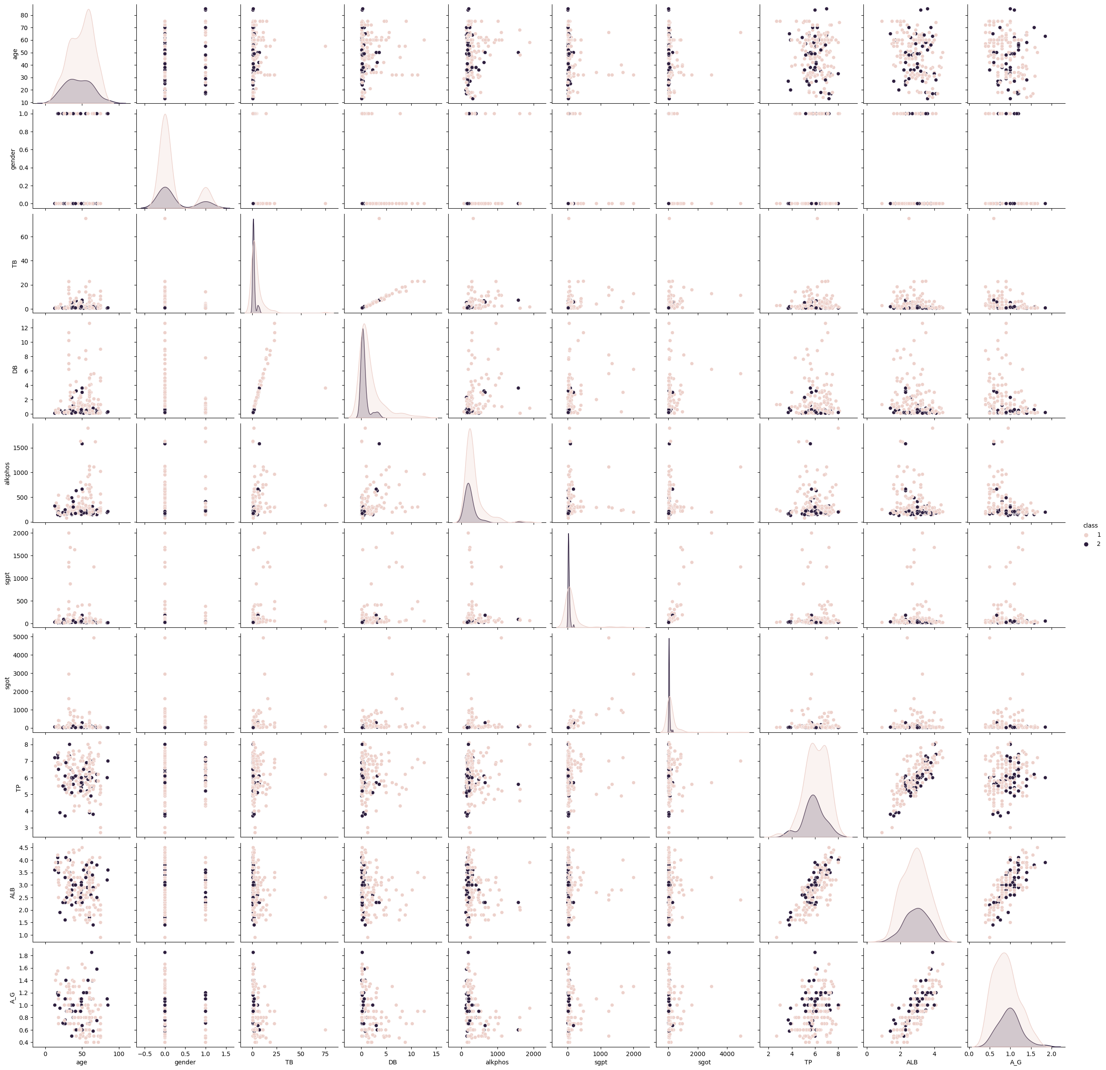
PAIR PLOT

Slide 6
PAIR PLOT Insight
The Pair plot are in bad/severe disarray, they are all overlapping, for this reason, it will be almost impost impossible to find independent variables
Again, when you look at the pair plot, you will see that some of the variables are clustered together,

Slide 7
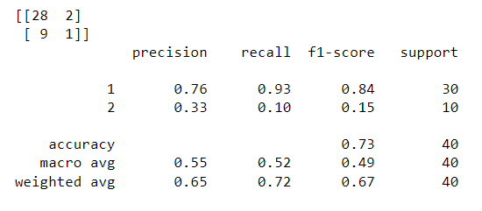
CONFUSION MATRIX
Of the (3) three algorithms
Confusion Matric/Classification for Logistical Regression

Slide 8
Insight for Logistical Regression
The Classification Report for each algorithm (precision, recall, f1, and support), as displayed in the results, is the model's performance based on the test data ( liverdataset) The confusion matrix is used to generate information for the Precision, Recall, and F1-score.
The Recall has a weighted average value of 72% it can predict 1 (liver disease) with up to 93% accuracy and a low prediction accuracy of 10% in predicting 2 (No liver disease)
The Precision has a weighted average of 65% and can predict 1 (liver disease) with up to 76% accuracy, and can only predict 2 (No liver disease) with 33% accuracy
F1-score has a 67% weighted average. it is most accurate in predicting 1 (liver disease) at up to 84% and less accurate in predicting 2 (No liver disease) at 15%

Slide 9
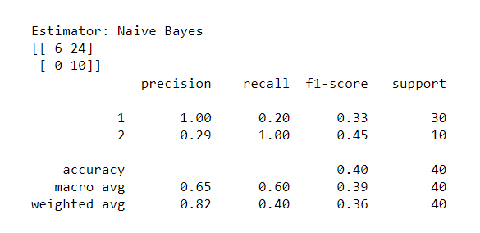
Confusion Matric/Classification for Naive Bayes

Slide 10
Insight for Naive Bayes
The Classification Report for each algorithm (precision, recall, f1, and support), as displayed in the results, is the model's performance based on the test data ( liverdataset) The confusion matrix is used to generate information for the Precision, Recall, and F1-score.
It has a precision value of 82% in the weighted average. It is most accurate in predicting 1 (Liver disease) at up to 100% and less accurate in predicting 2 (No liver disease) at 29%.
The F1-score has a 36% weighted average. It can predict 1 (Liver disease) with 33% accuracy and predict 2 (No liver disease) with 45% accuracy.
It has a weighted average recall value of 40%, with less accuracy of 20% in predicting 1 (Liver disease ) and can well predict 2 ( No liver disease) at 100%

Slide 11
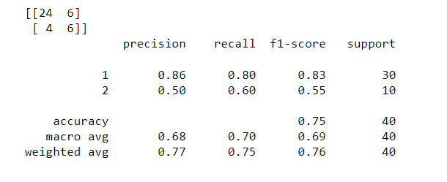
Confusion Matric/Classification for Neural Network

Slide 12
Insight for Neural Network
The Classification Report for each algorithm (precision, recall, f1, and support), as displayed in the results, is the model's performance based on the test data ( liverdataset) The confusion matrix is used to generate information for the Precision, Recall, and F1-score.
The Precision has a weighted average of 77% it is most accurate in predicting 1 “liver disease” at 86% and less accurate in predicting 2 “no liver disease” with 50%
Recall has a weighted average of 75% as it can predict 1 “liver disease” at 80% accuracy. And can predict 2 “no liver disease” at 60%
The F1-score has a weighted average of 76%. It is most accurate in predicting 1 (liver disease) up to 83% and less accurate in predicting 2 (no liver disease) up to 55%

Slide 13
RECOMMENDATION - State
I will recommend Neuro Network for Mr. John Hughes, looking at the out of the Classification Report for each algorithm (precision, recall, f1, and support), for the three (3) algorithms splayed in the results above,
First, you can see that the output from the Logistical Regression can predict 1 “liver disease” with its precision, Recall and F1-score have an accuracy output of 76%, 93% and 84% respectively, but could not predict 2 “No liver disease accurately, and its best prediction for 2 “No liver disease is 33% which is not good enough for the prediction,
Secondly, the Naïve bays Classification Report wasn’t good, its best accuracy for the prediction of 1 “Liver disease” was in precision which is 100% but Recall and F1-score are 20% and 33% respectively, this isn’t a good prediction, and this was the same in its weighted average, the best-weighted average was for precision which is 82% and the weighted average for Recall and F1-score is 36% and 40% respectively, not good.
However, when you look at the prediction of Neural Network, you will see that 1 which is Liver Disease has a good Classification Report for Precision, Recall and F1-score, with 86%, 80% and 83% values respectively,
Also, when you look at their weighted average, you will see that the Neural Network weighted average is better than logistical Regression and Naïve bays weighted average.
The good part about Neural Networks is that they can be improved for us to get a better prediction which it currently has

Slide 14
Possible Way to Improve the Model (Neural Network )
One way to improve the Neural Network is to change the hidden layers, we can do this by increasing the layers
The dataset is not balanced, Balancing the dataset will make it work better.
Neural work best in the presence of a lot of data.

Slide 15
References
Data-1200-04-Introduction to Data Analysis -Predictive Modeling Part II - Logistical Regression By Professor Sam, Plati,
Data-1200-04-Introduction to Data Analysis -Predictive Modeling Part IV - SVM and Naive BayesBy Professor Sam, Plati,
Data-1200-04-Introduction to Data Analysis Predictive Modeling Part V – Neural Networks
By Professor Sam, Plati,

